Slide 1
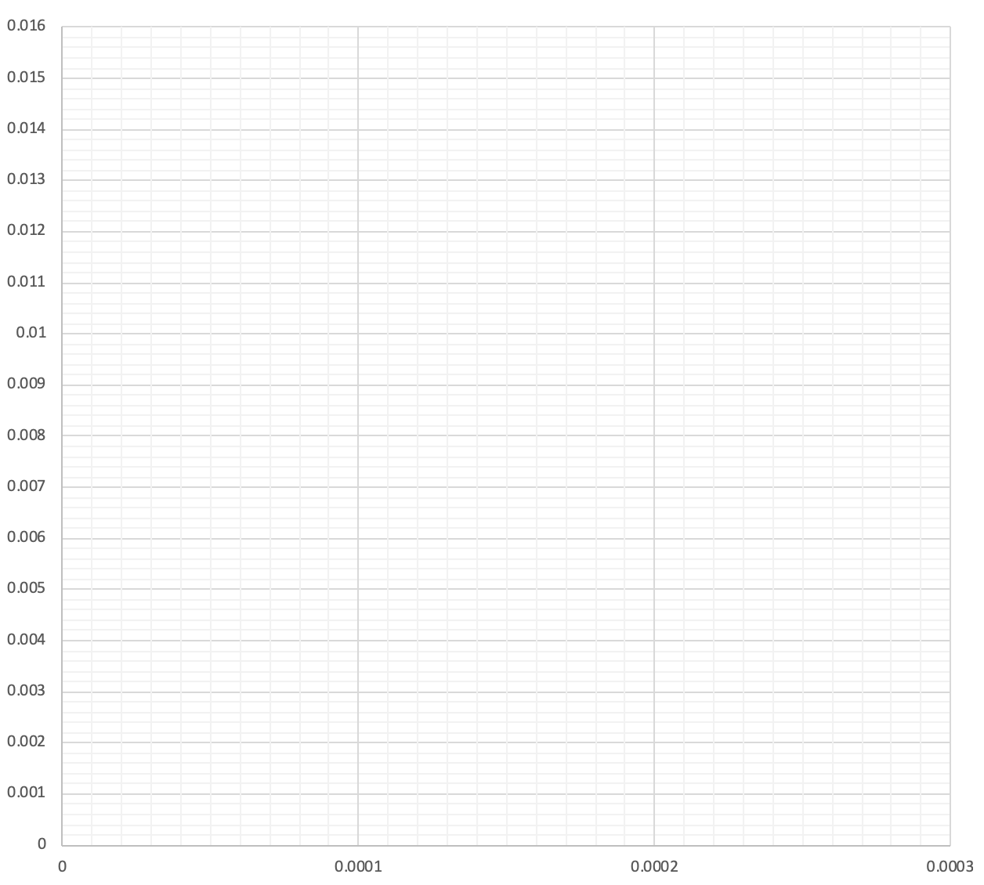
Exercise problem 1: dilute gas absorption
100 mol/hr of air containing 1% pollutant at 2 atm is to be cleaned of the pollutant such that at the end, its concentration is only 0.1%. A pure amine is being used as absorbent. Calculate number of stages if L/G = 2 (L/G)min. Calculate exit concentration of absorbent.
Hx = 100 bar

Slide 2
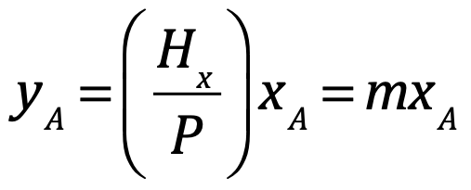
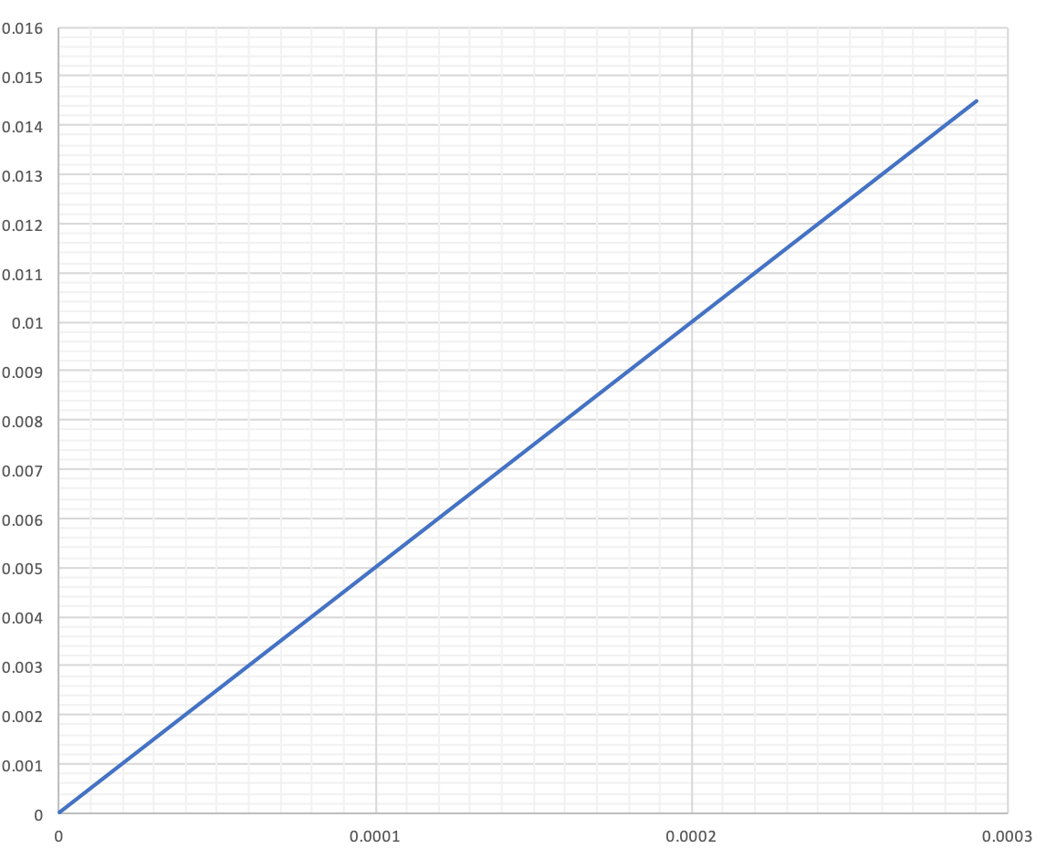
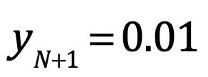
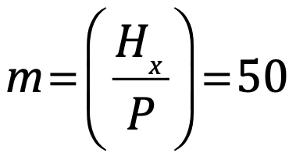
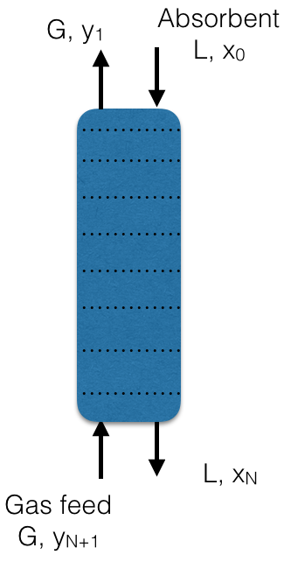
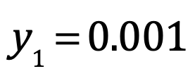
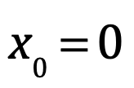
100 mol/hr of air containing 1% pollutant at 2 atm is to be cleaned of the pollutant such that at the end, its concentration is only 0.1%. A pure amine is being used as absorbent. Calculate number of stages if L/G = 2 (L/G)min. Calculate exit concentration of absorbent.
Hx = 100 bar

Slide 3
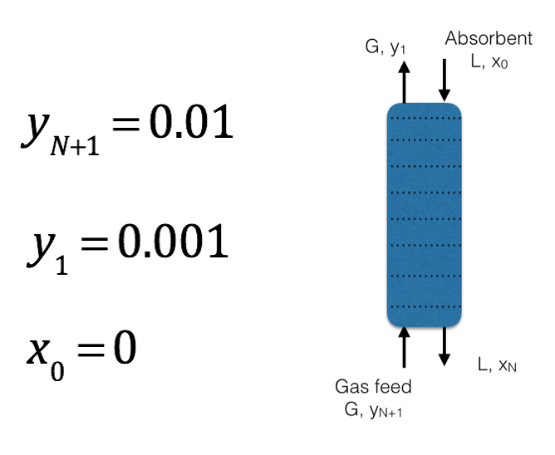
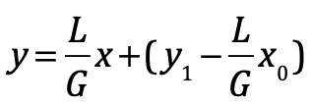
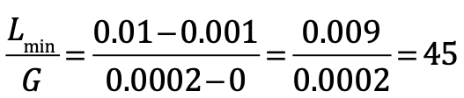
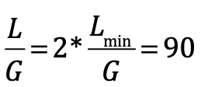

(3)
(2)
(1)
xN = 0.0001, number of stages = 3

Slide 4
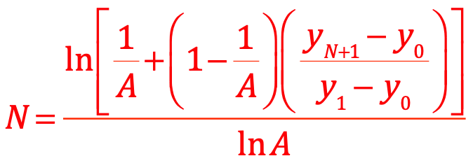
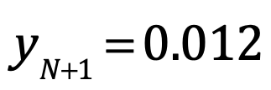
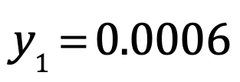
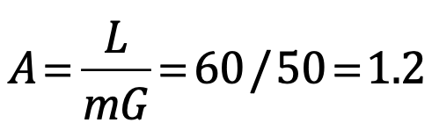
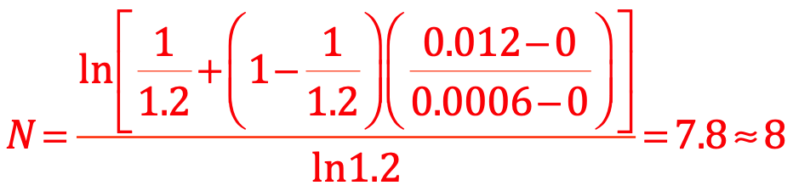
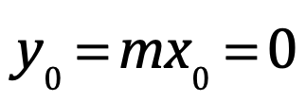
Exercise problem 2
100 mol/hr of flue gas containing 1.2% CO at 1 atm is to be cleaned of the CO such that at the end, its concentration is reduced by 20 fold. A pure absorbent is being used to remove CO. Calculate number of stages if L/G = 60. Calculate exit concentration of absorbent using Kremser equation.
Hx = 50 bar

Slide 5
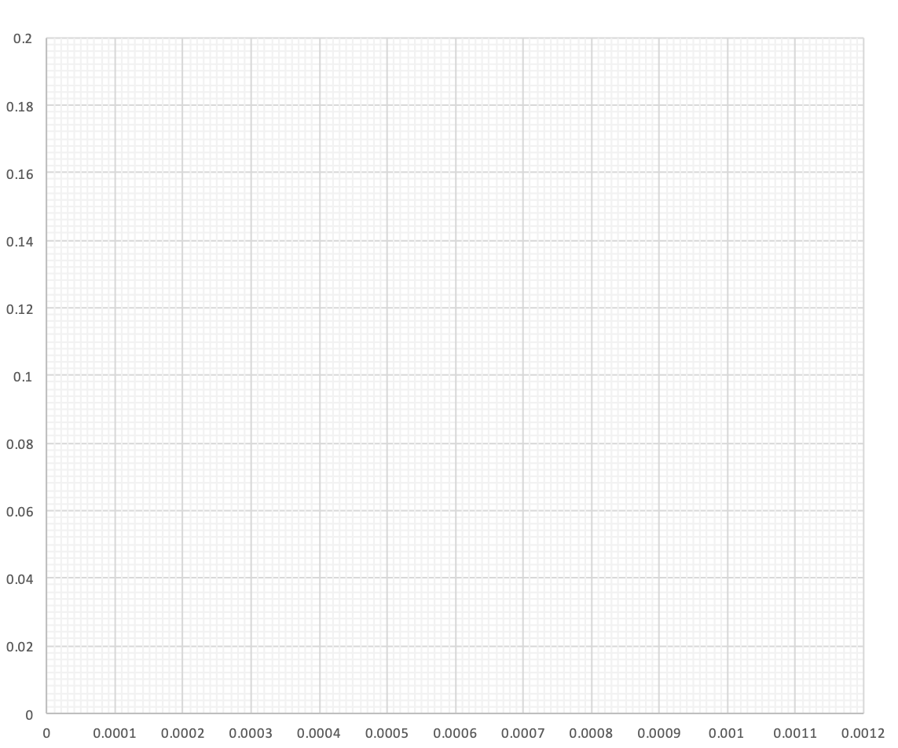
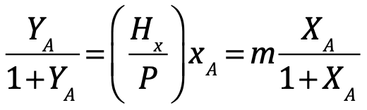
Exercise problem 3: concentrated gas absorption
100 mol/hr of air containing 15% pollutant at 2 atm is to be cleaned of the pollutant to reduce the concentration of pollutant to 2%. A pure amine is being used as absorbent. Calculate number of stages if LA/GC = 2 (LA/GC)min. Calculate exit concentration of absorbent.
Hx = 400 bar
x | y | X | Y
0 | 0 | 0 | 0
0.0001 | 0.02 | 0.0001 | 0.0204
0.0002 | 0.04 | 0.0002 | 0.0417
0.0003 | 0.06 | 0.0003 | 0.0638
0.0004 | 0.08 | 0.0004 | 0.087
0.0005 | 0.1 | 0.0005 | 0.1111
0.0006 | 0.12 | 0.0006 | 0.1364
0.0007 | 0.14 | 0.0007 | 0.1628
0.0008 | 0.16 | 0.0008 | 0.1905
0.0009 | 0.18 | 0.0009 | 0.2195
0.001 | 0.2 | 0.001 | 0.25
Y
m= 400/2 = 200
X

Slide 6
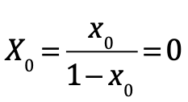
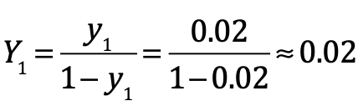
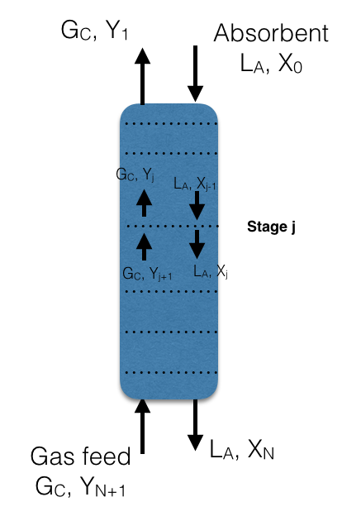
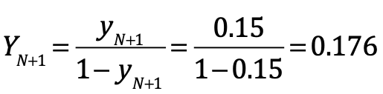


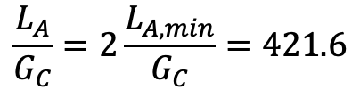

$$\frac{L_{A,min}}{G_{C}}$$
Y
$$\frac{L_{A}}{G_{C}}=2\frac{L_{A,min}}{G_{C}}=421.6$$
X
number of stages = 3

